Slide 1
SMART SAFETY VEHICLE USING ARDUINO
Submitted by
( LOKESH M & 201EE511)

Slide 2
ABSTRACT:
According to this project when a vehicle meets with an accident, this device will immediately detect the signal or if a car rolls over, and the Micro Electro Mechanical System (MEMS) sensor will detects the signal and sends it to arduino controller. Micro Controller sends the alert message through the GSM MODEM including the location to police control room or a rescue team.
So the police can immediately trace the location through the GPS MODEM, after receiving the information. Then after conforming the location necessary action will be taken. The main aim of this project is to develop a system automatic speed control of vehicle and accident avoidance using MQ3 Gas (alcohol ) sensor.
The vehicle is not started if the driver is consuming alcohol. Using LDR the headlight (LED) intensity has been controlled using ON/OFF Switch. When speed is crossing the limit the alarm will be on and it turns off automatically by sensing the speed.

Slide 3
PROJECT WORK PLAN:
The current scenario shows that the most of the road accidents are occurring due to drunk-driving. The drivers who drink alcohol are not in an stable condition and so, rash driving occurs on highway which can be risky to the lives of the people on road, the driver inclusive. The enormity of the dangerous driving transcends boundary. The laws in India are currently prohibiting drivers to drink and drive so that the fine can stop them to drink and drive.
Though the report declared speed violation is the foremost reason for these accidents, it will safely be inferred that almost all of the cases are because of drivers unstable condition caused by drivers becoming drunk citizen to be present additionally as state among identical house and time. This restricted ability of enforcement agents undermines each manual effort geared toward edge drink-driving. There is therefore the need for an alcohol detection system that k before they drive.
The investigation done by the Planet Health Organization in 2008 shows that concerning 50%-60% of traffic accidents square measure associated with drink-driving. Moreover, WHO information on road traffic deaths disclosed.

Slide 4
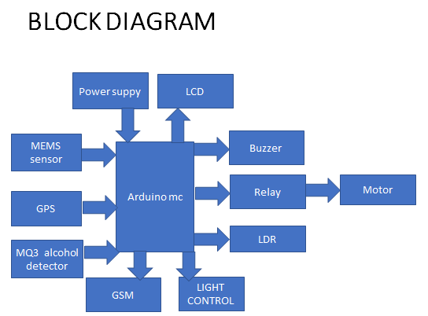
BLOCK DIAGRAM:

Slide 5
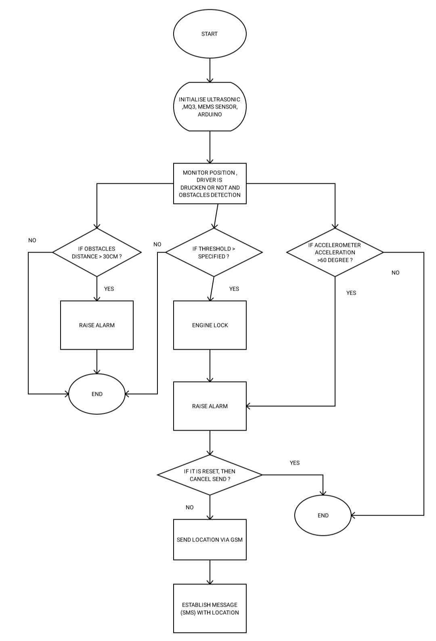
FLOW CHART:

Slide 6
Effective utilization of the Modern Tool & Cloud
The system consists of Arduino micro-controller unit, MEMS accelerometer, GPS device, GSM module, MEMS Sensor, and Alcohol sensor and LDR. An Accelerometer is used to detect the acceleration. It is the main sensor used to detect the accident. Once the accident is detected GPS collect the current position values which include latitude (N or S), longitude (E or W), date and time.
The location values are given to microcontroller. Controller gives this information to GSM module. By using GSM module we can send the message to family members or EMSA high performance 16/32 bit microcontroller unit is used to process and store real time signal from the accelerometer and various sensor. Motor stop automatically when alcohol is detected through alcohol sensor.. All the data of these sensor and GPS data are stored in memory card for analysis of accident cause. LDR is used to control the intensity of the light by trigger switch. Buzzer is ON when speed limit crossed.

Slide 7
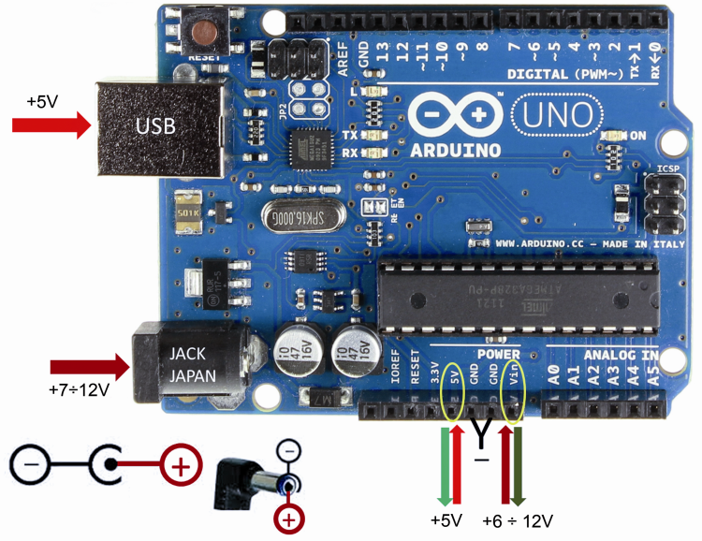
Technology stack & use case:
Must be a DC adapter (i.e. it has to put out DC, not AC).
should be between 9V and 12V DC
must be rated for a minimum of 250mA current output, although you will likely want something more like 500mA or 1A output, as it gives you the current necessary to power a servo or twenty LED if you want to.
Must have a 2.1mm power plug on the Arduino end.
The plug must be "centre positive", that is, the middle pin of the plug has to be the + connection.

Slide 8
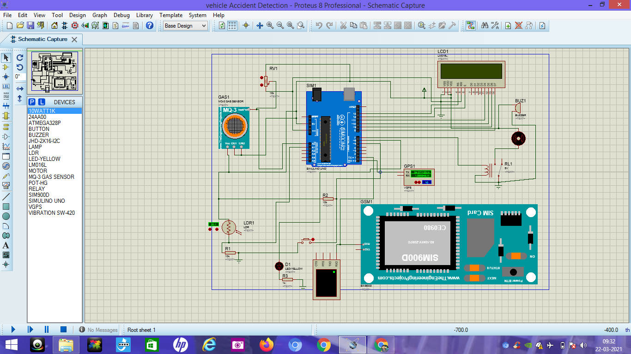
Prototype & Sample Output:
OVERALL SIMULATION DIAGRAM

Slide 9
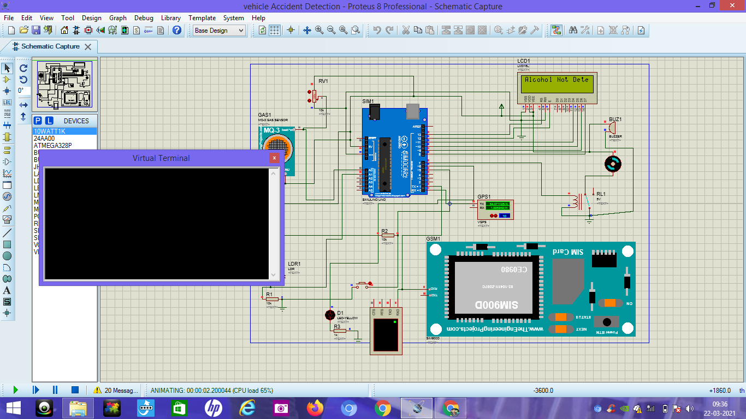
OUTPUT OF ALCOHOL DETECTION

Slide 10
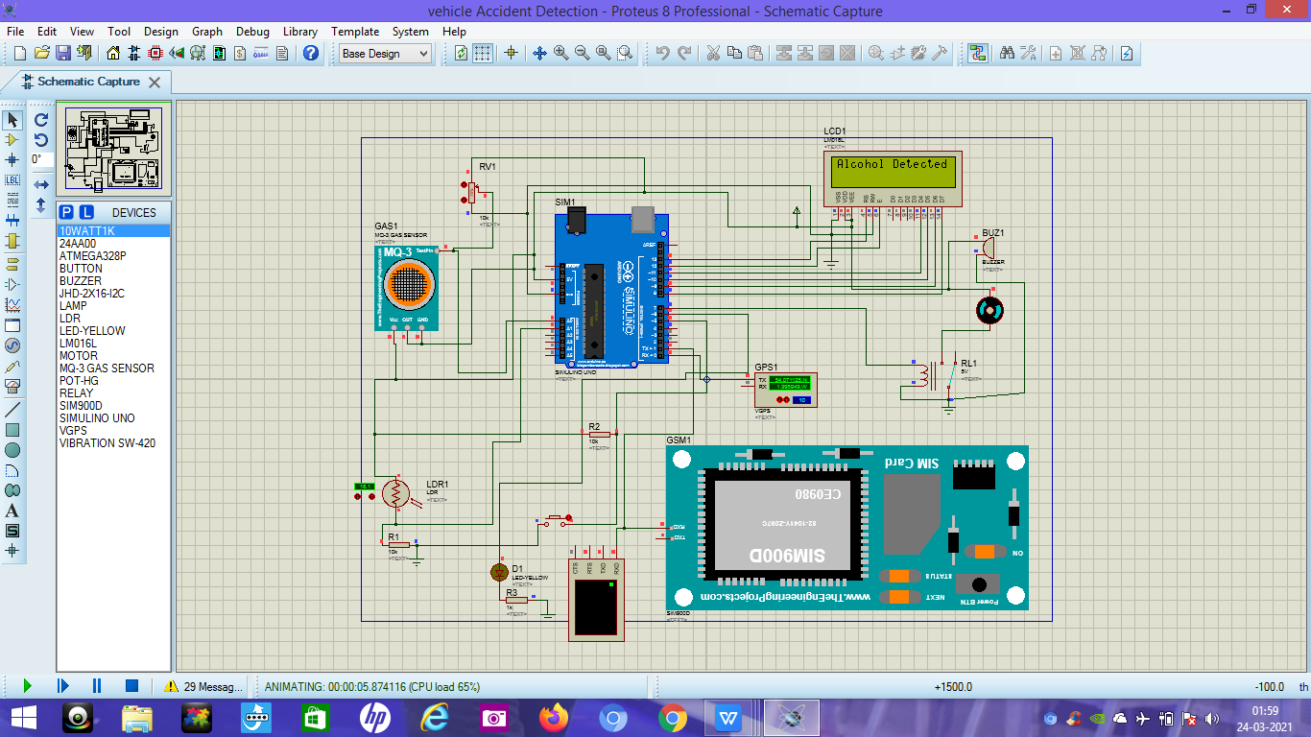
OUTPUT OF ACCIDENT DETECTION

Slide 11
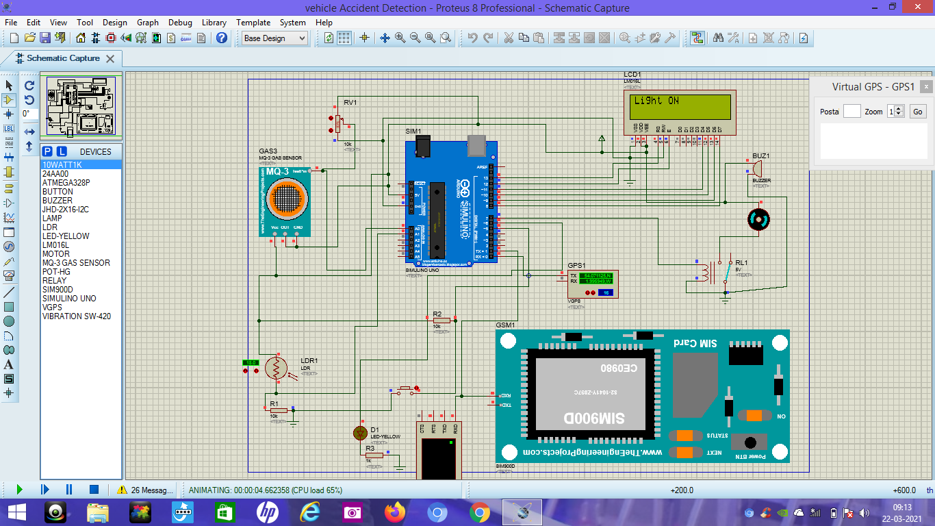
OUTPUT OF PHOTO TRANSISTOR

